Slide 1

Getting Started with VALORANT
Riot api bootcamp
riot-api-bootcamp.thinkific.com

Slide 2


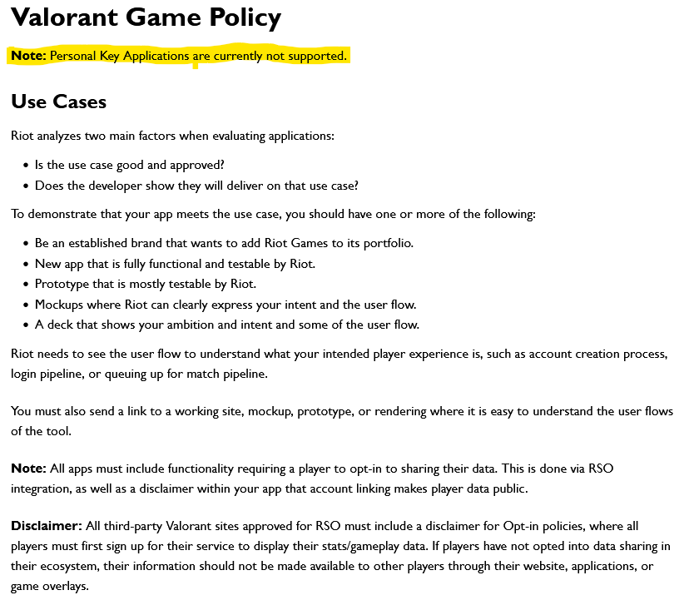


Why is valorant different?

Slide 3



How does this compare with other Riot Games products?
League of Legends
Riot API was originally designed for LoL
Variety of endpoints
Supports tournament game creation
Legends of Runeterra
Gets card info, game state
Mostly interacts with client
Teamfight Tactics
Similar end points to LoL
Specific data is limited (item names, but not effects)
3

Slide 4
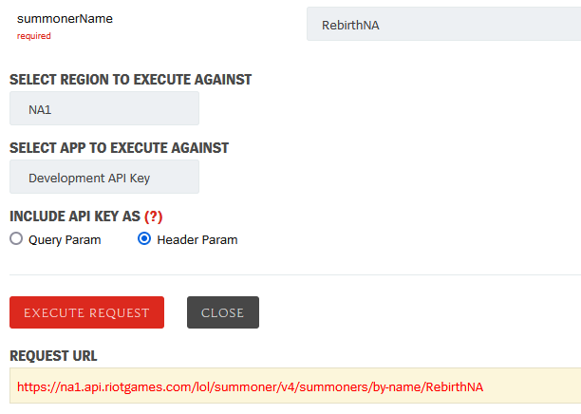
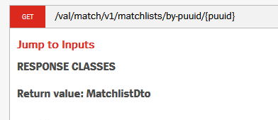
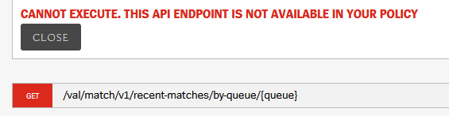
API methods comparison
Summoner-v4 (League)
Val-match-v1 (Valorant)

Slide 5
So how can I build an app without any access?
Riot API BOOTCAMP
riot-api-bootcamp.thinkific.com

Slide 6
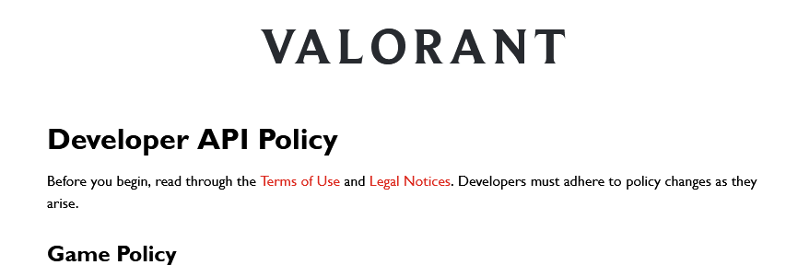
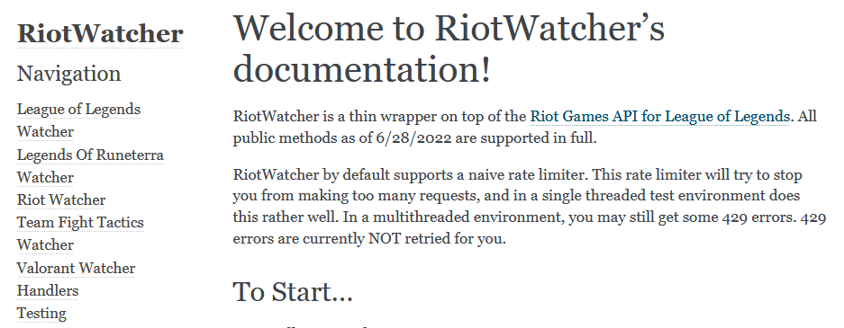
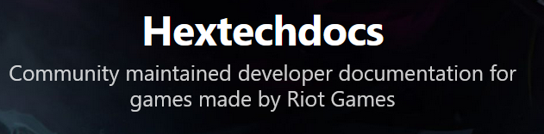
Finding Documentation
There is no official documentation for the Valorant API
Often information is in multiple places
Riot API recommendations: https://developer.riotgames.com/docs/valorant
Python library specific: Riot Watcher (https://riot-watcher.readthedocs.io/en/latest/index.html)
Community documentation: Hextechdocs (https://hextechdocs.dev/)

Slide 7
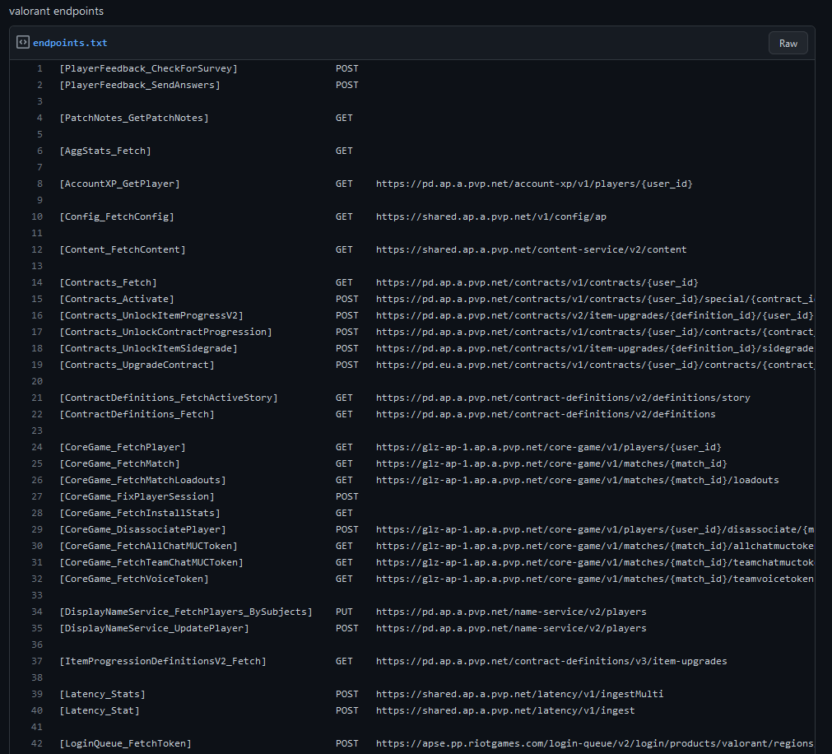
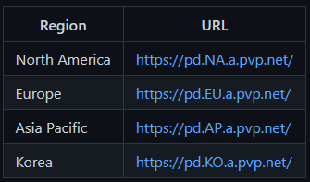
VALORANT API Endpoints
The community has figured it out mostly by trial and error
Riot has their servers split up between regions, so each region has their own URL.
https://gist.github.com/Kavan72/b6e0bfdf21d610148f64df878b8a2cc5

Slide 8


Questions?
Contact me
It is my hope that this course is easy to understand and follow
Have a question or want additional details? Just reach out!
If you want to know more about my work (LoL Genius) or have questions about something you’re building, LMK!

